Slide 1
AAD – Platform Developer Productivity
Technology – Platform Team : Oct 2023

Slide 2
1. Publish Subscribe Efficiency
Usability : Publish Subscribe Efficiency - Publish Subscribe Efficiency Currently, common controls like OUCode, Source Context, GUID etc., needs to be manually published - subscribed to the link or help screens. Since these controls are common across user interfaces, when any link or help is provided, can we automatically have them published and subscribed, if we are willing to go with standard naming of the controls >> APRP-1184
Solutioning → Engineering Setup → Setup UI Preference
This activity must be mapped to PLFADMIN role.
Specified common hidden controls will be auto-populated in newly created user interfaces.
If the "auto pub-sub" option is selected, the system will automatically incorporate these controls into the publication and subscription.
When common controls match in both the parent and child user interfaces, the system will automatically perform resolve link dataitem.
Managed through System Parameter - es_quick_code_met (AutoPubSub)

Slide 3
2. Productivity: Default Required
Productivity: Default Required Option in ML: Default Required Option in ML: Defaults required property of a multiline column should be automatically selected for editable and combo controls. Now there are old screens having multiline which can be enabled with this option at once for the existing multiline. For new screens when the multiline is added, most cases, this property is missed to be selected. Hence auto selection of this property is required.
Managed trough system parameters (metadata table name – es_quick_code_met )
AUTO_DEFAULT_ML_COMBO
AUTO_DEFAULT_ML_EDIT
Applicable only for newly created interfaces

Slide 4
3. Quality: Tool to review the delta changes of ECR
Tool to review the delta changes of ECR
Ramco.Plf.Doc.Analyzer is a desktop application used to generate comparison report between two ECRs for customer, project, and component within a platform model.

Slide 5
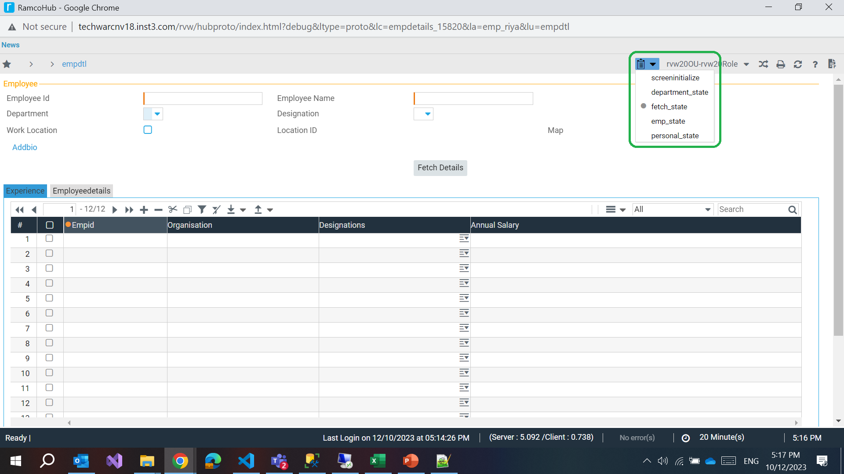
4. State in proto
Provision to preview ui proto with states
Platform state xml’s are generated as part of preview
Solutioning engineers can preview the user interface state by choosing the appropriate state from the ILBO toolbar.
iRule state xml to be planned

Slide 6
5. Proto with templates & tiles
Provision to preview ui proto with templates, icons and tiles
Define a template and its associated CSS
Map datatype for value parameters and task type of actions
Specify sample data.
Preview the template individually in an atomic manner.Facility to
Associate the template with header assorted controls and grid template columns.
Preview the user interface with the included templates and tiles.

Slide 7
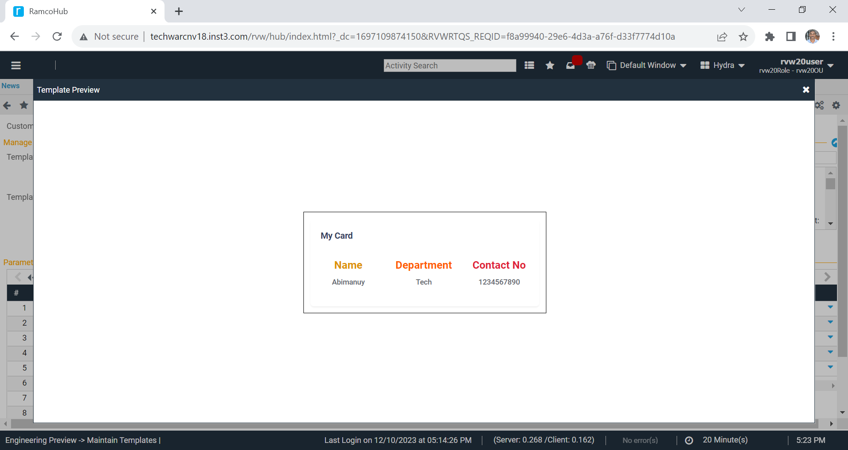
5. Proto with templates & tiles

Slide 8
6. Grid column auto re-sequencing
Provision to auto re-sequence column and column group
Consider a grid having sequence number 1, 2, 3, 4 and 5
If a solutioning engineer wants to insert a column after 2, the new column should be designated as 2.1
Likewise, if a column is to be added after 4, the new column should be labeled as 4.1
Upon saving, the system will automatically re-sequence the columns to become 1, 2, 3, 4, 5, 6, and 7.

Slide 9
7. Hiding un-used links
Hide the links which are not applicable - (ex: eZeeView)
Below un-used links are hidden
Component | Activity | Link
Preview | Specify Layout | Validate
Preview | Specify Layout | Specify eZee View
Preview | Specify Layout | Specify Custom Section
Preview | Specify Layout | Specify Device Configuration
Preview | Specify Layout | Specify Template
Preview | Specify Layout | Design Template
Requirements Engineering | Specify Behaviour | Validate
Requirements Engineering | Specify Behaviour | Specification

Slide 10
8. Validation for segment dataitem defaults
TECH-73518 - Validation for default values of segment data items and method parameters
Applicable only for
new service segment dataitems
only for manual service design
char = ~#~
int = -915
date = 01-01-1900

Slide 11
9. Validations
TECH-72956 - Validation to restrict hidden view definition for list edit controls
TECH-72725 - Validation to restrict work request publish when no columns are defined for listedit controls
TECH-69657 - List loading - System allowed to map the single segment dataitem for listview control. But it should allow only for multi segment data items.
TECH-69282 - List view modelling is incomplete.
LVWMHI_Symbolcode_Combo is involved in publication dataitem which should not be done. System allowed to publish the ECR and not validated.
TECH-71003 - Codegen is getting continuously failed for BASWC component. activity :-WCRwCapCer ; ui:-AdvanceSearch ; section :- RwAsJqurSec control synonym :-RwAs_RulesR in this UI there is an improper rule builder control which has no definition of grid and header grid columns. System allowed to publish ECR without definition for grid in rule builder.

Slide 12
10. Bulk Validations
TECHB-924 - Bulk validation for ECR publish
TECHB-924 - Bulk validation for RCN publish

Slide 13
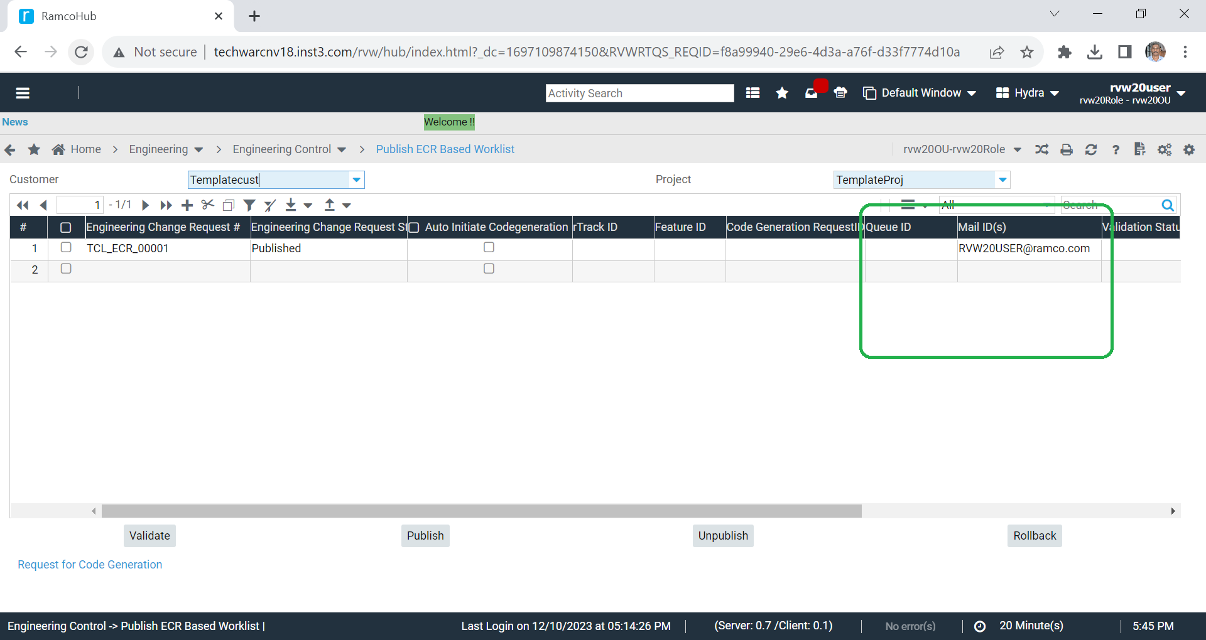
11. ECR Publish
TECHB-925 - Publish ECR in offline mode (queuing)

Slide 14
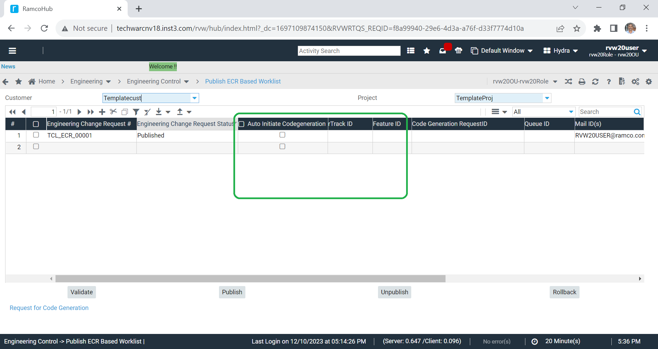
12. Code Generation
TECHB-926 - Provision to initiate code generation as part of publish ECR
Provision to download generated code from view code generation request screen
Managed through system parameter es_quick_code_met (OfflinePublishECR)

Slide 15
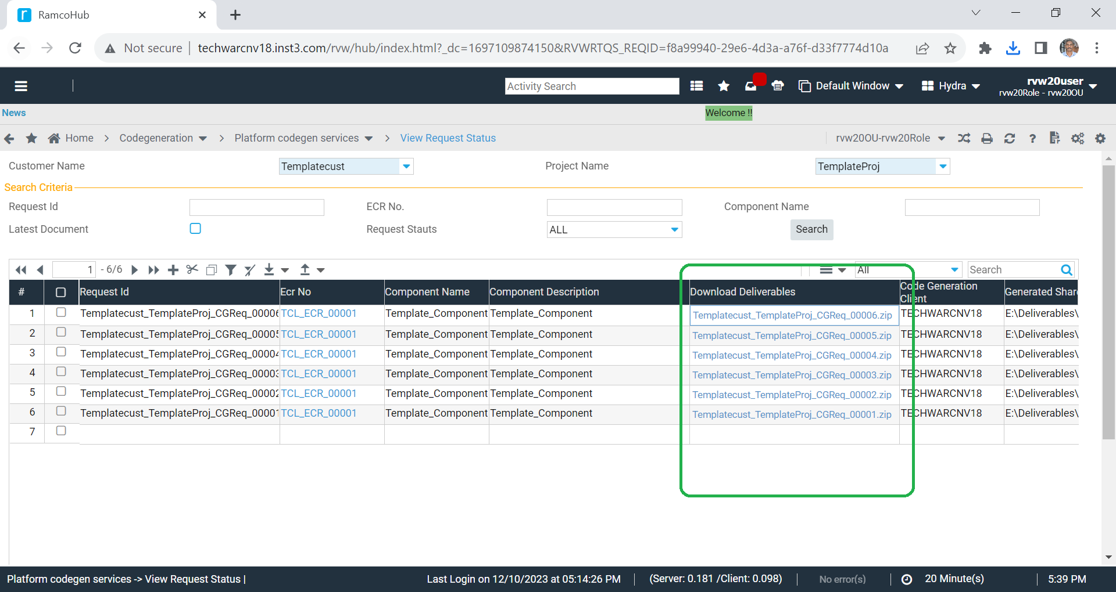
12. Code Generation

Slide 16
13. Metadata cleanup
Metadata clean-up for service definition -
Cached
ClearKeyPattern

